Slide 1
Machine Learning Foundation Stock Price and Trend Prediction
Name : Abhinav Nimje
Cohort : July 2020
Dataset Source : QUANDL
Term : Term 3

Slide 2
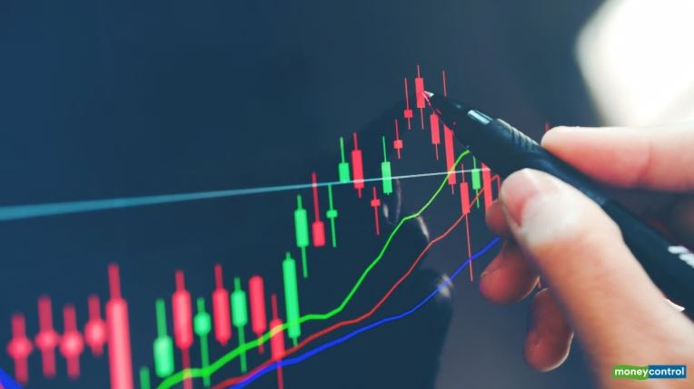
Introduction
This Study is to perform Machine Learning Algorithms on Stock Price Data for Jindal Stainless (Hisar) Ltd.
This dataset contains End of Day prices for stock for last 5 years.
Based on Open, High, Low and Close prices, both linear and classification Algorithms will be used.
Classification Algorithm will be used to find out Trend and Regression will be used to find out future price prediction.

Slide 3
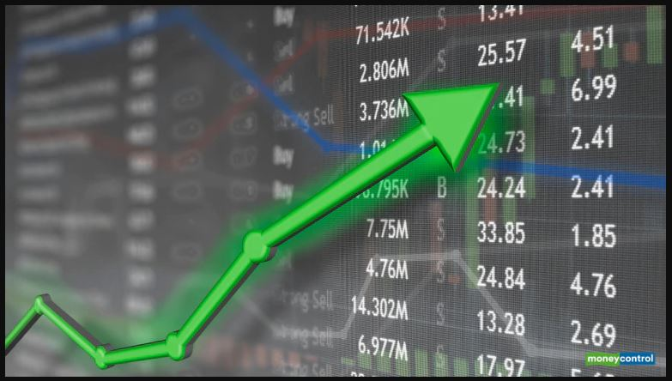
Problem Statement & Scope
With data provided for Open High Low Close (OHLC), we need to find out trend and Future closing price.
There will be 2 types Algorithms used to achieve mentioned problem statement.
Regression to Predict Stock Closing Price.
And Classification to find out Trend of Stock.
Few more fields needs to be added to the dataset to make study more powerful.
Scope of Study:
Study is carried out for Jindal Stainless (HISAR) Ltd..
Data considered for the study is from last 5 years to till date.
For the sake of simplicity, Volume and Volume in delivery is not considered.
Few Moving averages are included to make study powerful.

Slide 4

Libraries Used

Slide 5

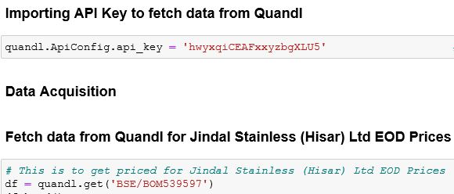
QUANDL
Get millions of financial and economic datasets from hundreds of publishers directly into Python. Most datasets on Quandl, whether in time-series or tables format, are available from within Python, using the free Quandl Python package. The Quandl package uses our API and makes it amazingly easy to get financial data.

Slide 6
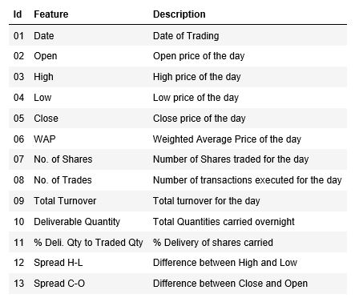
Data Description

Slide 7
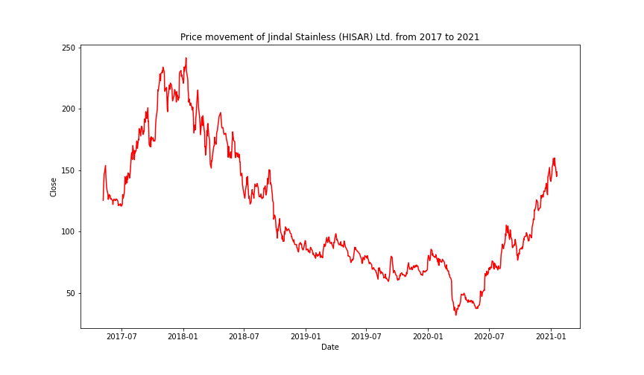
Price Trend for given duration

Slide 8
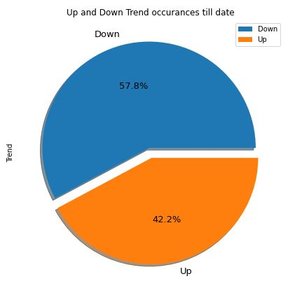
UP and DOWN trend
Maximum times the Stock has closed in Red or Down trend. But at the same time we can conclude that the dataset is not imbalanced and we can apply Classification Algorithms on the same.

Slide 9
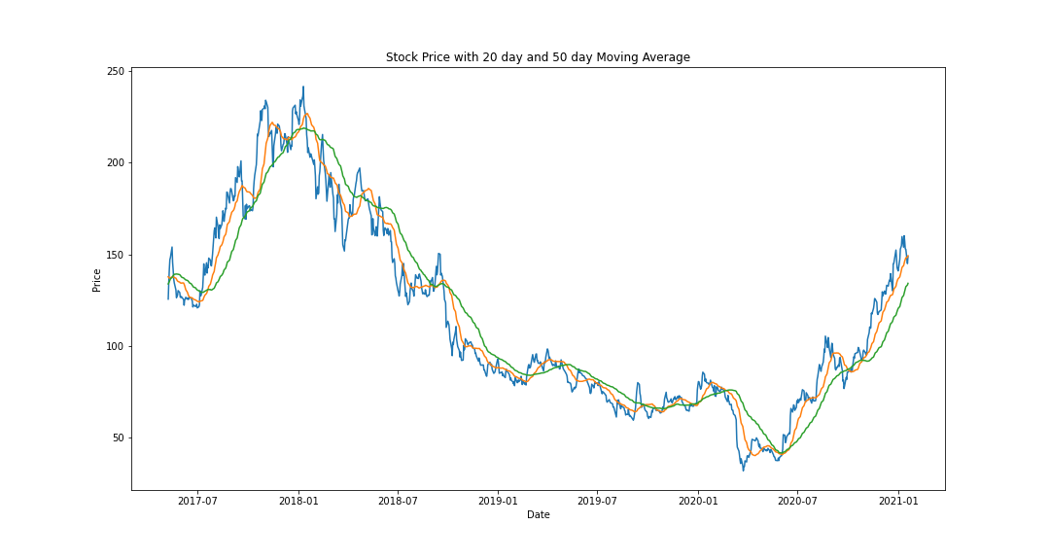
Price vs. MA20 vs. MA50

Slide 10
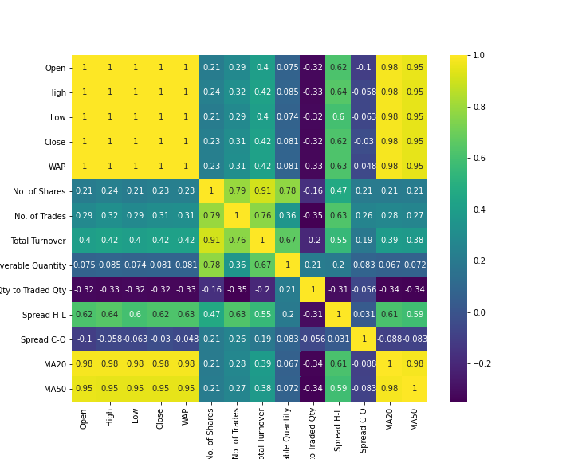
Which are correlated fields?
Heat map shows detailed correlation with the other features in the dataset.

Slide 11
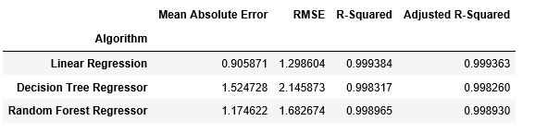
Regression Algorithms
Based on the Scores, looks like Linear Regression is performing well in this regression problem statement when we are predicting Closing Price.

Slide 12
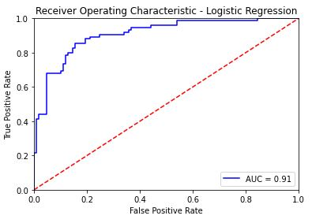
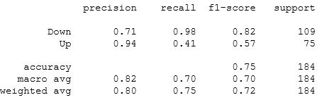
Classification Algorithms
Logistic Regression
Confusion Matrix
[ [107 2] [44 31] ]
Classification Report

Slide 13
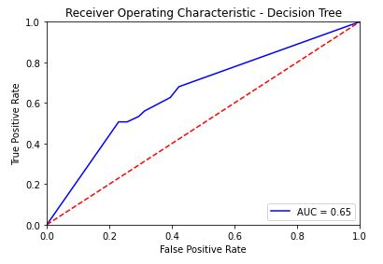
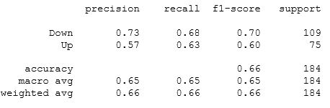
Classification Algorithms
Decision Tree Classifier
Confusion Matrix
[ [74 35] [28 47] ]
Classification Report

Slide 14
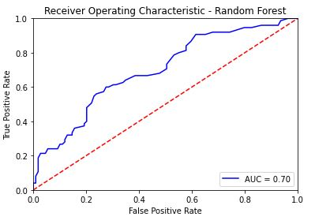
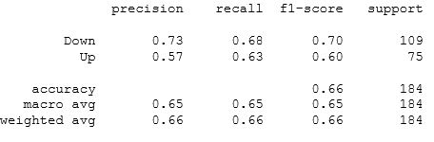
Classification Algorithms
Random Forest Classifier
Confusion Matrix
[ [84 25] [34 41] ]
Classification Report

Slide 15
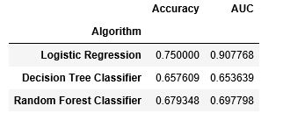
Classification Algorithms
Based on the Scores, looks like Logistic Regression is performing well in this regression problem statement when we are predicting Trend.

Slide 16
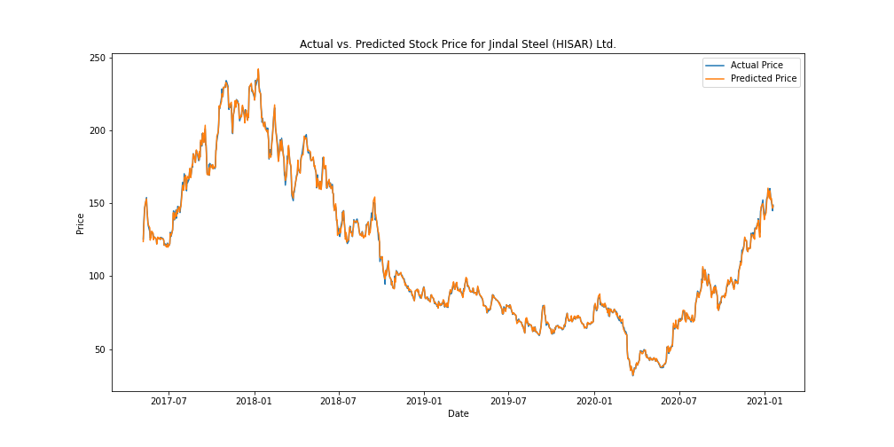
Conclusion (Regression)
This graph shows pictorial view of Actual Closing Price Vs. Predicted Price (Using Linear Regression). And both results are behaving in almost same manner. So, we can conclude that Linear Regression is performing very well.

Slide 17
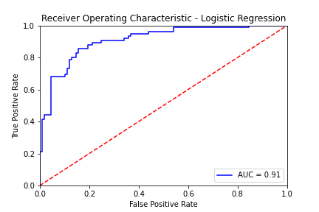
Conclusion (Classification)
Based on above ROC/AUC curve, it is clear that with Logistic Regression, Area Under Curve is 91% and Accuracy is 75%. So, we can conclude that Logistic Regression is performing very well.

Slide 18


